Slide 1

Programming One (csc7050)
Aidan McGowan
OOP – instance and static variables

Slide 2
Local variables
Examples so far have declared all variables within a method.
Variables declared in the body of a particular method are known as local variables and can be used only in that method.
This is known as the scope of the variable.
When that method terminates the values of its local variables are lost.

Slide 3
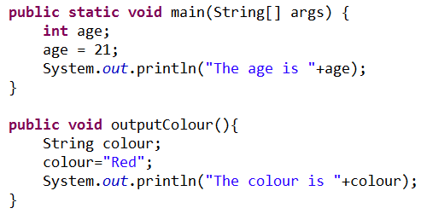
Local variables scope
In this example there are two local variables declared, namely age and colour. As both are declared within separate methods the scope of the variables is limited within their individual method. This is the scope of the variables.
Attempting to refer to variables beyond their scope will cause a compile time error.

Slide 4
Instance variables
Recall that classes in OOP have methods and attributes.
Attributes are variables that belong to each instance of the class and are known as Instance variables.
A class normally consists of one or more methods that manipulate the attributes that belong to a particular object of the class. Usually known as getters (accessors) and setters (mutators)
Student
- name: String
+ setName( name: String ) + getName( ) : String

Slide 5
UML class diagram
Student
- name: String
+ setName( name: String ) + getName( ) : String
UML class diagram indicating that class Student has a private name attribute of UML type String and two public operations
setName (with a name parameter of UML type String)
getName (which returns UML type String)

Slide 6
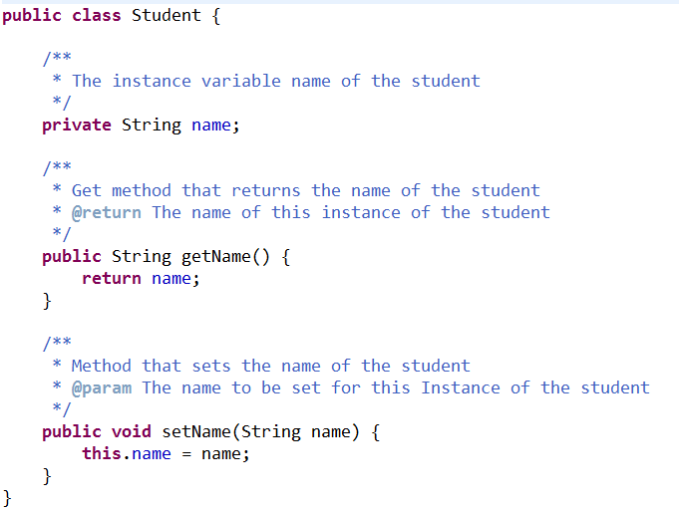
Implementation of student class as per UML class diagram
Instance variable declaration
Get method
Set method

Slide 7
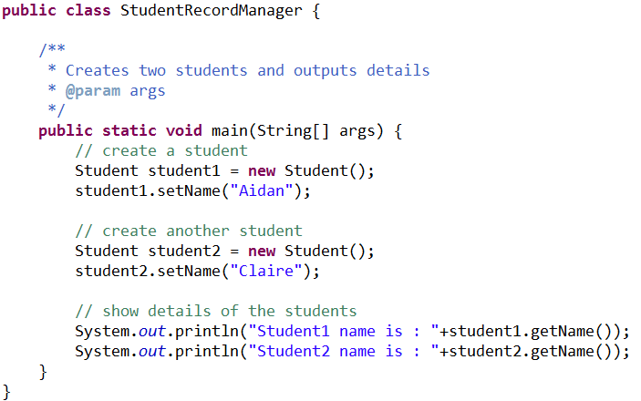
Instantiation of the class
student1
name = “Aidan”
Two student objects created
student2
name = “Claire”

Slide 8


Output via get methods

Slide 9


OOP - Exercise I
Create the following classes… to represent the two mountains.
Output the details of each to screen.
Mountain
name: String height : int
+ setName( name: String ) + getName( ) : String + setHeight( name: int ) + getHeight( ) : int
Everest 8848
Slieve Donard 828
Notes:
/**
* Class represents a mountain
* @author amcgowan
*
*/
public class Mountain {
/**
* The name of the mountain
*/
private String name;
/**
* The height of the mountain
*/
private int height;
/**
* @return the name
*/
public String getName() {
return name;
}
/**
* @param name the name to set
*/
public void setName(String name) {
this.name = name;
}
/**
* @return the height
*/
public int getHeight() {
return height;
}
/**
* @param height the height to set
*/
public void setHeight(int height) {
this.height = height;
}
}
_________________________________________________________________________
public class MountainReport {
public static void main(String[] args) {
Mountain m1 = new Mountain();
m1.setName("Everest");
m1.setHeight(8848);
Mountain m2 = new Mountain();
m2.setName("Slieve Donard");
m2.setHeight(828);
System.out.println(m1.getName() +" " +m1.getHeight());
System.out.println(m2.getName() +" " +m2.getHeight());
}
}

Slide 10
Static variables
Every object has its own copy of all the instance variables of the class.
In certain cases, only one copy of a particular variable should be shared by all objects of a class.
A static field— called a class variable —is used in such cases. A static variable represents classwide information.
All objects of the class share the same piece of data. The declaration of a static variable begins with the keyword static.

Slide 11


Static variables – space invaders
Consider a game in which if there is a solo Space Invader then it stays green and will not attack !
But if there are four or more together then they turn red and will attack!
Each Space Invader needs to know the spaceInvaderCount
Option 1 - each Space Invader object has its own instance member of the count. But each time the count needs to change then each instance has to update its count. (High maintenance, efficiency issues, redundant data and is error prone.)
Option 2 - declare spaceInvaderCount to be static, making the count classwide data. Each Space Invader can see the count as if it were an instance variable of each class but only one copy of the static spaceInvaderCount is maintained. Less update errors, etc….

Slide 12
Static variables
Static variables have class scope. You can access a class’s public static members through a reference to any object of the class, or by qualifying the member name with the class name and a dot (.), as in Math.PI
A class’s private static class members are normally accessed by client code only through methods of the class. Actually, static class members exist even when no objects of the class exist—they’re available as soon as the class is loaded into memory at execution time.
To access a public static member when no objects of the class exist (and even when they do), prefix the class name and a dot (.) to the static member, as in Math.PI. To access a private static member when no objects of the class exist

Slide 13


Accessing static members and methods

Slide 14
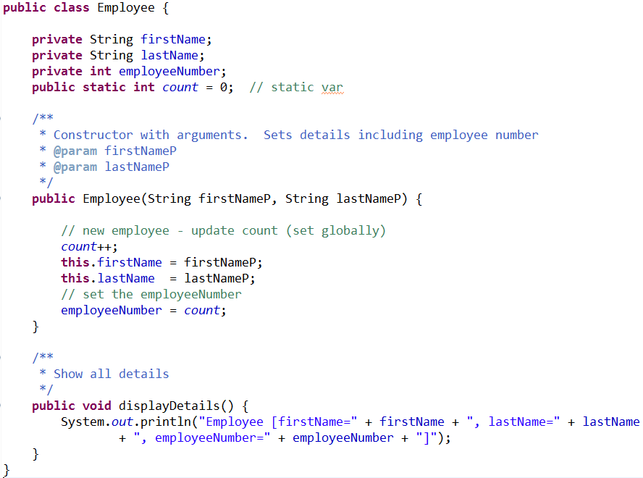
Static variables example
Static variable declaration and set at zero initially
Each time an employee is created the employee count is updated and the value assigned to the new employee’s staff number.

Slide 15
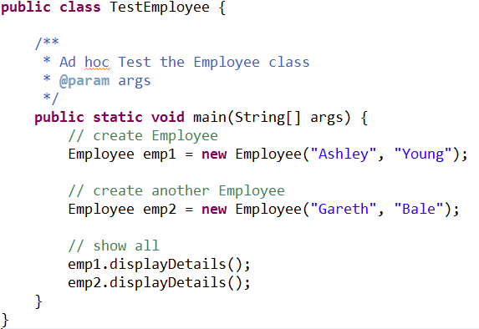
Test run of Employee class

Slide 16

Static method and instance variables
A static method cannot access non-static class members, because a static method can be called even when no objects of the class have been instantiated. For the same reason, the this reference cannot be used in a static method. The this reference must refer to a specific object of the class, and when a static method is called, there might not be any objects of its class in memory.
Notes:
package lecture.demos;
public class StaticNonos {
// static var
public static int score = 1;
// instance var
private int age=21;
public static void main(String[] args) {
// this is ok - because main is a static method
System.out.println(score);
// but this is not allowed - static method cannot access non static (instance) vars
//System.out.println(this.age);
// and this neither
//this.gimmeSome();
// but this is OK
StaticNonos sn = new StaticNonos();
System.out.println(sn.age);
}
/**
* Non static method
*/
public void gimmeSome(){
// this is OK - non static method accessing non static field
System.out.println(this.age);
// and this is OK too... non static method access static field
System.out.println(score);
// this is ok too - calling a non static from a non static (a recursive call - more later)
this.gimmeSome();
}
}

Slide 17
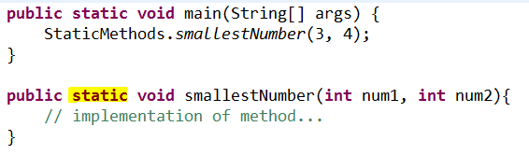
Static methods
Similar rules to creating and accessing static variables.
ClassName.methodName( arguments )

Slide 18

OOP - Exercise II
Create the Robot class
In a separate class named “RobotFactory” create at least two instances of the Robot. Each robot object should be assigned the next “free ID” for its ID.
Robot
name: String ID : int - nextID:int
+ setName( name: String ) + getName( ) : String + getID( ) : int + assignID()
Class (i.e. static) methods and fields are indicated by underlining
The assignID method will assign the NEXT available ID to the robot AND update (increment) the STATIC nextID field

